Slide 1
Bayesian Decision Theory
Mathematical foundation for decision making.
Using probabilistic approach to help making decision (e.g., classification) so as to minimize the risk (cost).

Slide 2
Bayesian Decision Theory
Design classifiers to make decisions subject to minimizing an expected ”risk”.
  The simplest risk is the classification error (i.e., assuming that misclassification costs are equal).
  When misclassification costs are not equal, the risk can include the cost associated with different misclassifications.

Slide 3
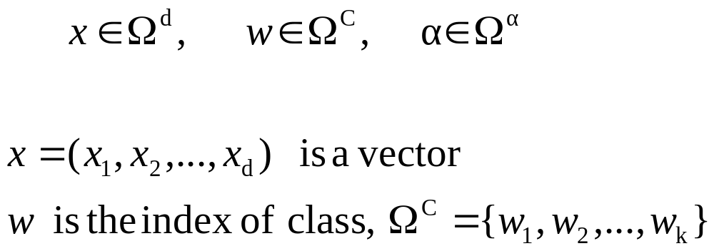
Diagram of pattern classification
Procedure of pattern recognition and decision making
subjects
Observables
X
Features
x
Inner belief
w
Action
α
X--- all the observables using existing sensors and instruments
x --- is a set of features selected from components of X,
or linear/non-linear functions of X.
w --- is our inner belief/perception about the subject class.
--- is the action that we take for x.
We denote the three spaces by

Slide 4
Examples
Ex 1: Fish classification
X=I is the image of fish,
x =(brightness, length, fin#, ….)
w is our belief what the fish type is
Ω^{c}={“sea bass”, “salmon”, “trout”, …}
α is a decision for the fish type,
in this case Ω^{c}= Ω^{α}
Ω^{α} ={“sea bass”, “salmon”, “trout”, …}
Ex 2: Medical diagnosis
X= all the available medical tests, imaging scans that a doctor can order for a patient
x =(blood pressure, glucose level, cough, x-ray….)
w is an illness type
Ω^{c}={“Flu”, “cold”, “TB”, “pneumonia”, “lung cancer”…}
α is a decision for treatment,
Ω^{α} ={“Tylenol”, “Hospitalize”, …}

Slide 5
Tasks
subjects
Observables
X
Features
x
Inner belief
w
Decision
α
control
sensors
selecting
Informative
features
statistical
inference
risk/cost
minimization
In Bayesian decision theory, we are concerned with the last three steps in the big ellipse assuming that the observables are given and features are selected.

Slide 6
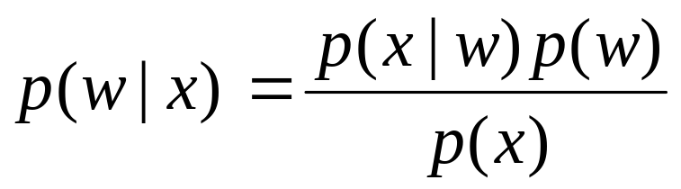
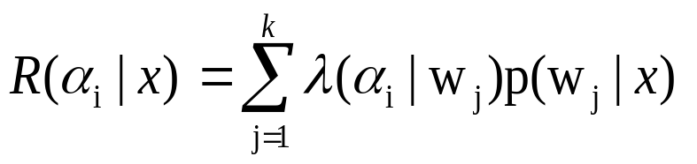
Bayesian Decision Theory
statistical
Inference
risk/cost
minimization
Features
x
Inner belief
p(w|x)
Decision
α(x)
Two probability tables:
a). Prior p(w)
b). Likelihood p(x|w)
A risk/cost function
(is a two-way table)
λ(α | w)
The belief on the class w is computed by the Bayes rule
The risk is computed by

Slide 7
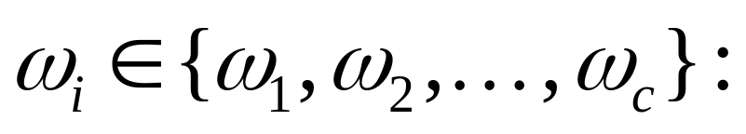
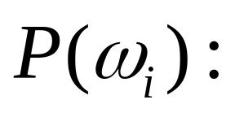

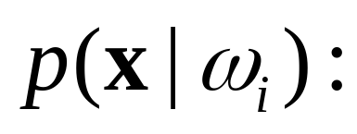
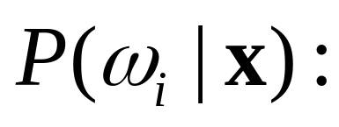
Preliminaries and Notations
a state of nature
prior probability
feature vector
class-conditional
density
posterior probability

Slide 8
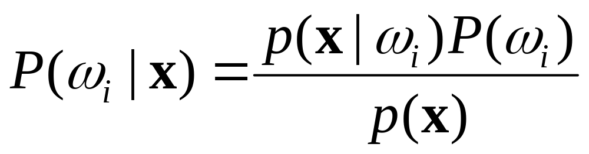
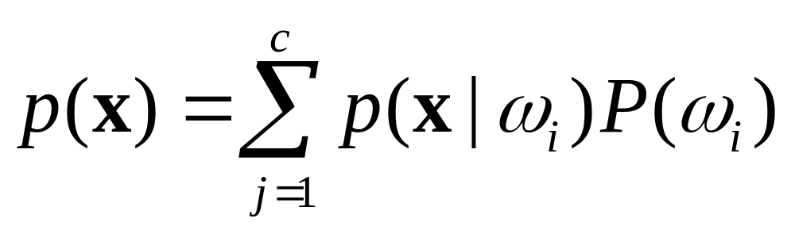
Bayesian Rule

Slide 9
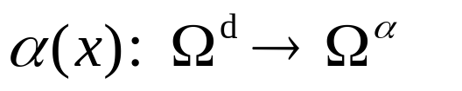
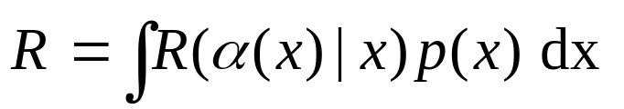
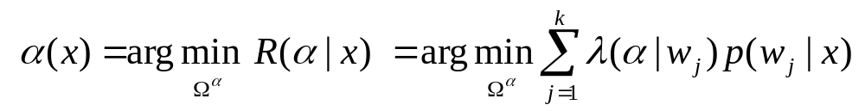
Decision Rule
A decision rule is a mapping function from feature space
to the set of actions
randomized decisions won’t be optimal.
A decision is made to minimize the average cost / risk,
It is minimized when our decision is made to minimize the cost / risk for each instance x.

Slide 10
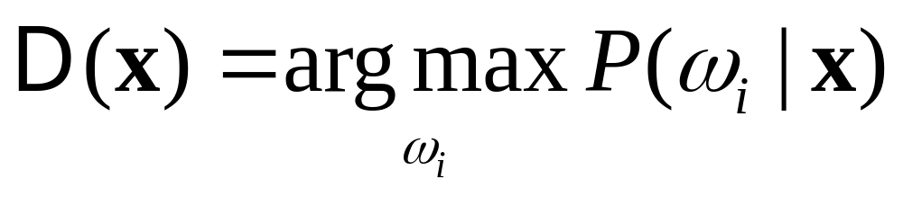
Decision
unimportant in
making decision

Slide 11

Decision
Decide ω_{i} if P(ω_{i}|x) > P(ω_{j}|x) ∀ j ≠ i
Decide ω_{i} if p(x|ω_{i})P(ω_{i}) > p(x|ω_{j})P(ω_{j}) ∀ j ≠ i
Special cases:
P(ω₁)=P(ω₂)= ⋅ ⋅ ⋅=P(ω_{c})
p(x|ω₁)=p(x|ω₂) = ⋅ ⋅ ⋅= p(x|ω_{c})

Slide 12
Two Categories
Decide ω_{i} if P(ω_{i}|x) > P(ω_{j}|x) ∀ j ≠ i
Decide ω_{i} if p(x|ω_{i})P(ω_{i}) > p(x|ω_{j})P(ω_{j}) ∀ j ≠ i
Decide ω₁ if P(ω₁|x) > P(ω₂|x); otherwise decide ω₂
Decide ω₁ if p(x|ω₁)P(ω₁) > p(x|ω₂)P(ω₂); otherwise decide ω₂
Special cases:
P(ω₁)=P(ω₂)
Decide ω₁ if p(x|ω₁) > p(x|ω₂); otherwise decide ω₁
2. p(x|ω₁)=p(x|ω₂)
Decide ω₁ if P(ω₁) > P(ω₂); otherwise decide ω₂

Slide 13
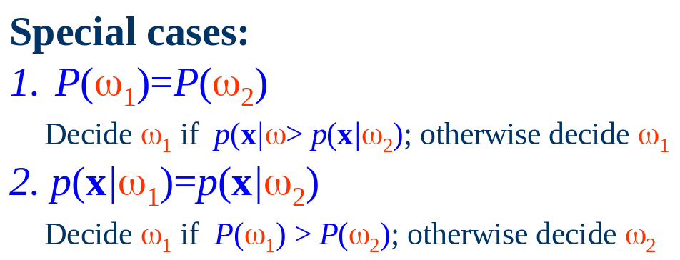
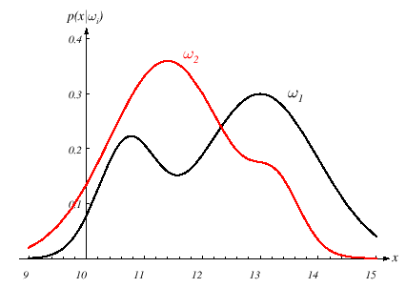
Example
R₂
R₁
P(ω₁)=P(ω₂)

Slide 14
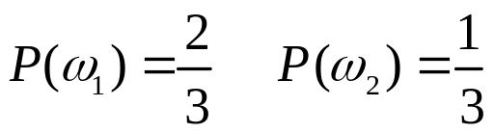
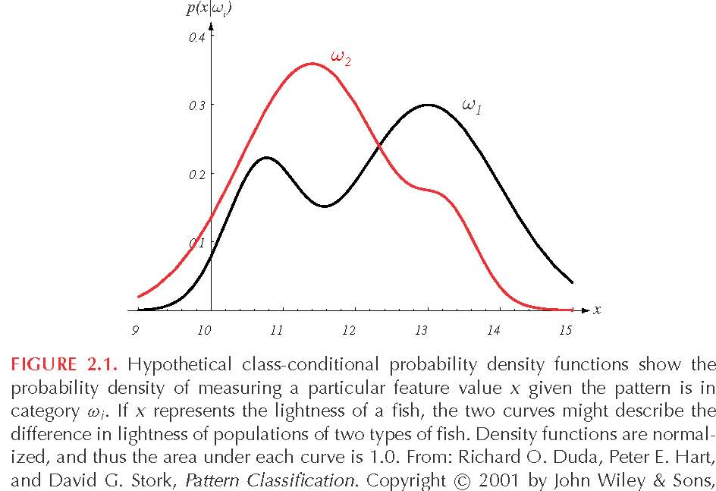
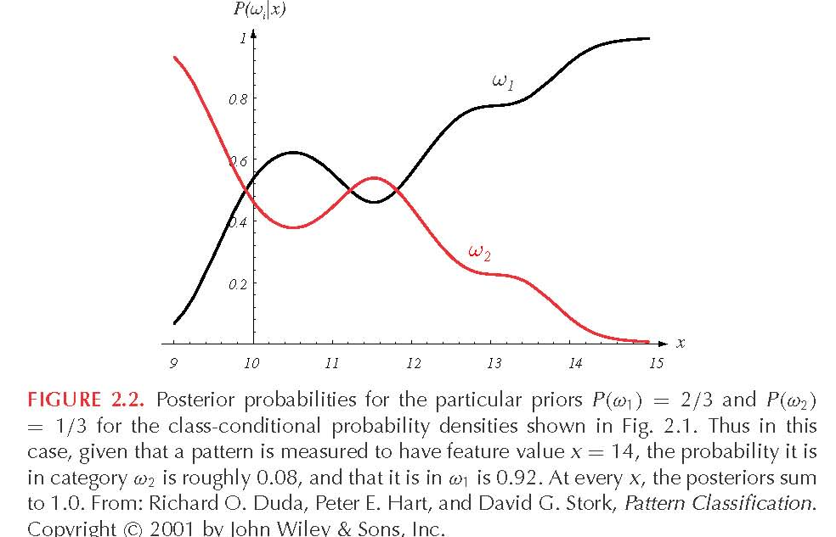
Decision Rule Using Conditional Probabilities
p(x/ω_{j})
P(ω_{j} /x)

Slide 15
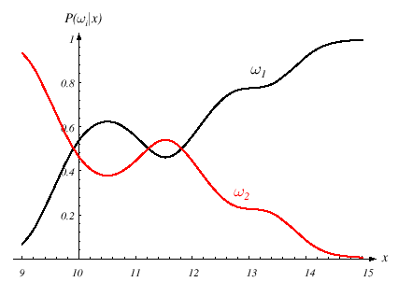
Example
P(ω₁)=2/3
P(ω₂)=1/3
R₂
R₁
R₂
R₁
Decide ω₁ if p(x|ω₁)P(ω₁) > p(x|ω₂)P(ω₂); otherwise decide ω₂

Slide 16
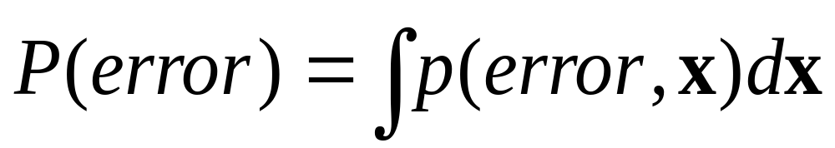
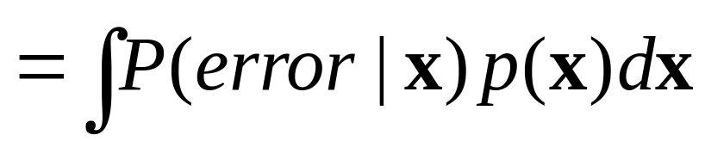
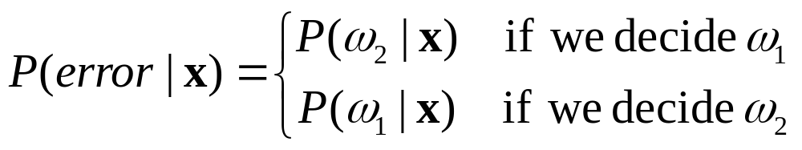

Classification Error
Consider two categories:
Decide ω₁ if P(ω₁|x) > P(ω₂|x); otherwise decide ω₂

Slide 17
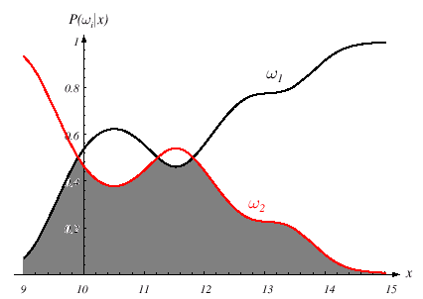
Classification Error
Consider two categories:
Decide ω₁ if P(ω₁|x) > P(ω₂|x); otherwise decide ω₂

Slide 18
Generalized Bayesian Decision Rule

Slide 19
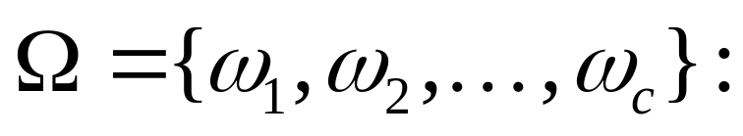
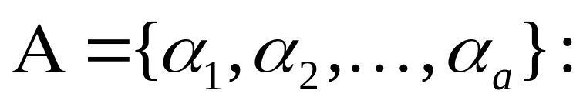
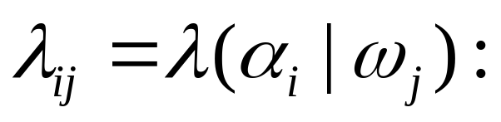
The Generation
a set of c states of nature
a set of a possible actions
The loss incurred for taking action α_{i} when the true state of nature is ω_{j}.
can be zero.
Risk
We want to minimize the expected loss in making decision.

Slide 20
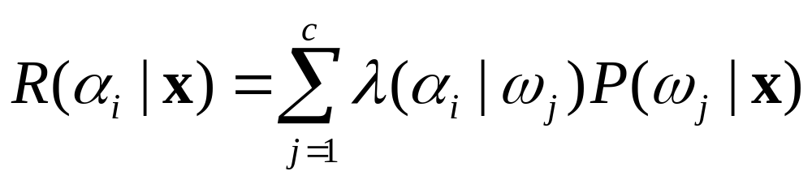
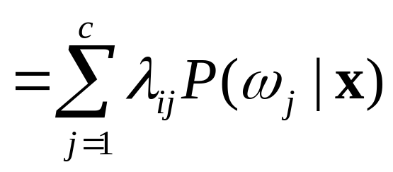
Conditional Risk
Given x, the expected loss (risk) associated with taking action
α_{i}.

Slide 21
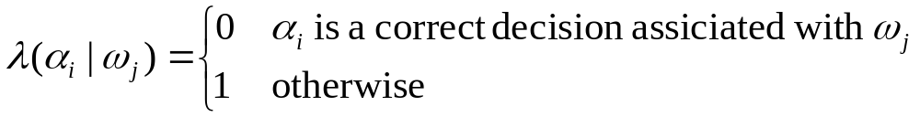
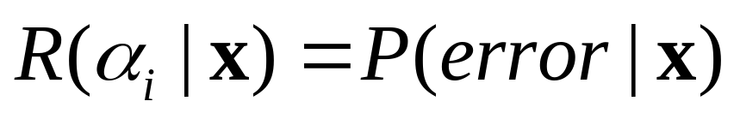
0/1 Loss Function

Slide 22
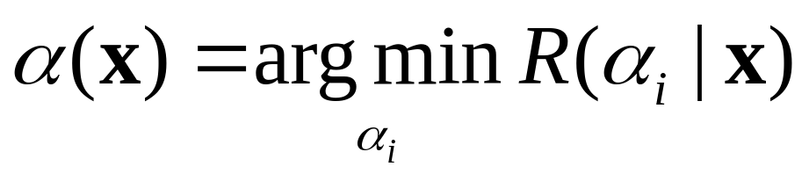
Decision
Bayesian Decision Rule:

Slide 23
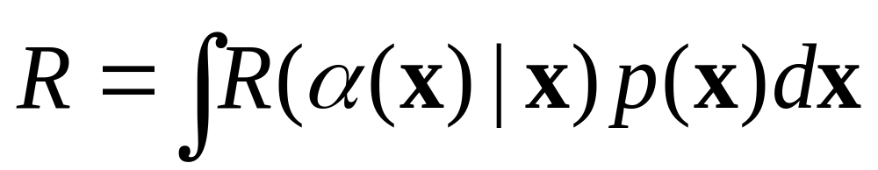
Overall Risk
Decision function
Bayesian decision rule:
  the optimal one to minimize the overall risk
  Its resulting overall risk is called the Bayesian risk

Slide 24
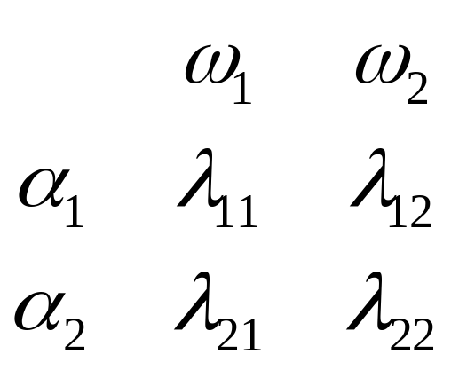
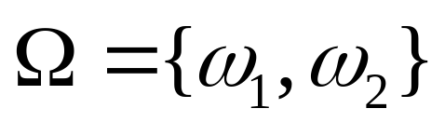
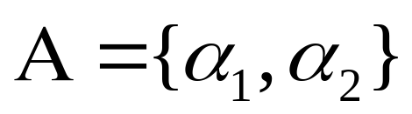
Two-Category Classification
State of Nature
Loss Function
Action

Slide 25
Two-Category Classification
Perform α₁ if R(α₂|x) > R(α₁|x); otherwise perform α₂

Slide 26
Two-Category Classification
Perform α₁ if R(α₂|x) > R(α₁|x); otherwise perform α₂
positive
positive
Posterior probabilities are scaled before comparison.

Slide 27
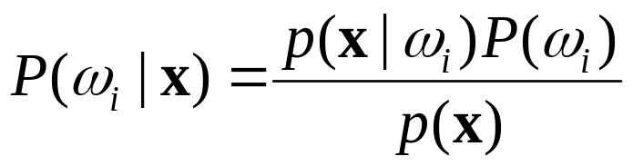
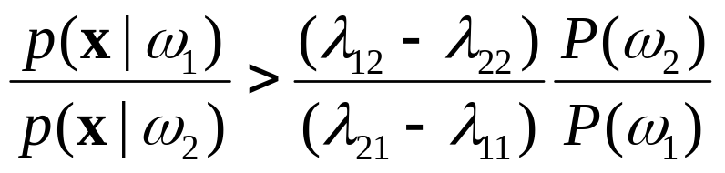
Two-Category Classification
irrelevant
Perform α₁ if R(α₂|x) > R(α₁|x); otherwise perform α₂

Slide 28
Two-Category Classification
Threshold
Likelihood
Ratio
Perform α₁ if

Slide 29
Discriminant Functions

Slide 30
The Multi-category Classification
How to define discriminant functions?
g_{i}(x)’s are called the discriminant functions.
g₁(x)
g₂(x)
Action
(e.g., classification)
x
α(x)
g_{c}(x)
Assign x to ω_{i} if
g_{i}(x) > g_{j}(x) for all j ≠ i.

Slide 31
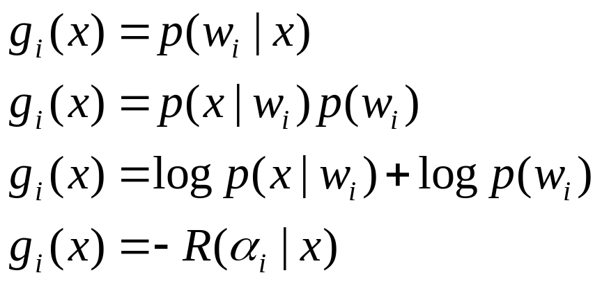
Discriminant functions
To summarize, we take an action to maximize some
discriminant functions

Slide 32
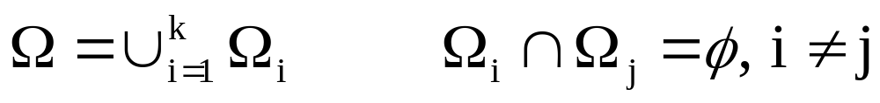
Partition of feature space
The decision is a partition /coloring of the feature space into k subspaces
5
3
2
1
4

Slide 33
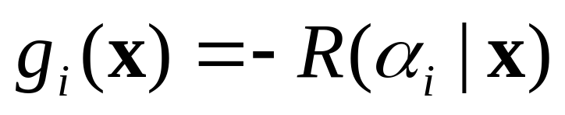
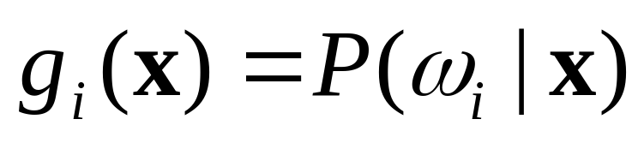
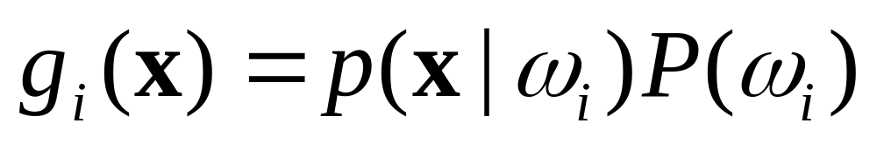
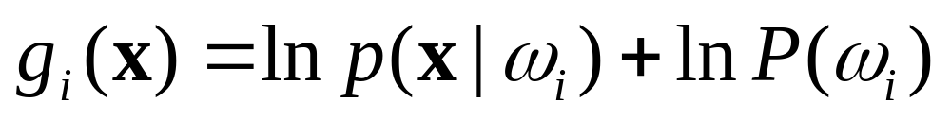
Simple Discriminant Functions
If f(．) is a monotonically increasing function, than f(g_{i}(．) )’s are also be discriminant functions.
Minimum Risk case:
Minimum Error-Rate case:

Slide 34
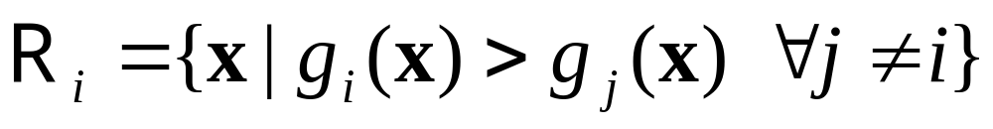
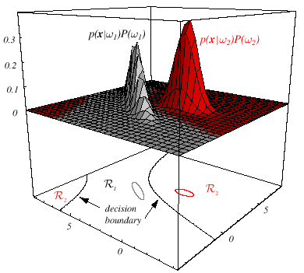
Decision Regions
Two-category example
Decision regions are separated by decision boundaries.

Slide 35
The Normal Distribution

Slide 36

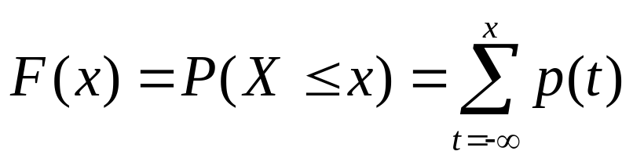

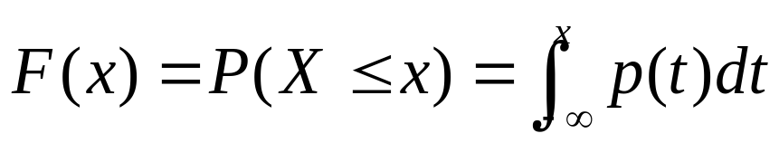
Basics of Probability
Discrete random variable (X) － Assume integer
Probability mass function (pmf):
Cumulative distribution function (cdf):
Continuous random variable (X)
Probability density function (pdf):
not a probability
Cumulative distribution function (cdf):

Slide 37
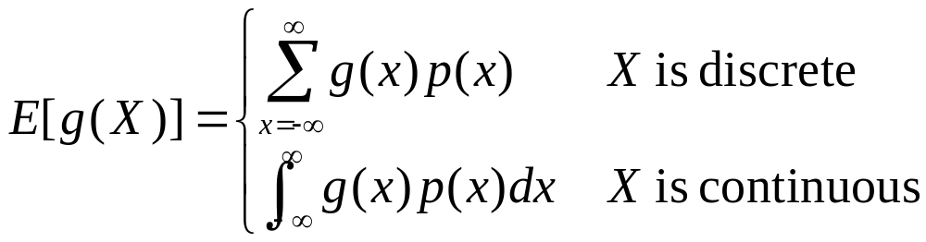
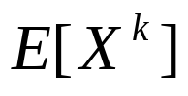

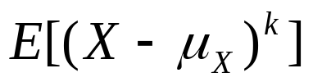
Expectations
Let g be a function of random variable X.
The k^{th} moment
The 1st moment
The k^{th} central moments

Slide 38



Important Expectations
Mean
Variance

Slide 39

Entropy
The entropy measures the fundamental uncertainty in the value of points selected randomly from a distribution.

Slide 40

Univariate Gaussian Distribution
Properties:
Maximize the entropy
Central limit theorem
X~N(μ,σ²)
p(x)
μ
x
σ
σ
E[X] =μ
2σ
2σ
3σ
3σ
Var[X] =σ²

Slide 41





Random Vectors
A d-dimensional
random vector
Vector Mean:
Covariance Matrix:

Slide 42


Multivariate Gaussian Distribution
X~N(μ,Σ)
A d-dimensional random vector
E[X] =μ
E[(X-μ) (X-μ)^{T}] =Σ

Slide 43
Properties of N(μ,Σ)
X~N(μ,Σ)
A d-dimensional random vector
Let Y=A^{T}X, where A is a d × k matrix.
Y~N(A^{T}μ, A^{T}ΣA)

Slide 44

Properties of N(μ,Σ)
X~N(μ,Σ)
A d-dimensional random vector
Let Y=A^{T}X, where A is a d × k matrix.
Y~N(A^{T}μ, A^{T}ΣA)

Slide 45




On Parameters of N(μ,Σ)
X~N(μ,Σ)

Slide 46



More On Covariance Matrix
∑ is symmetric and positive semidefinite.
Φ: orthonormal matrix, whose columns are eigenvectors of ∑.
Λ: diagonal matrix (eigenvalues).

Slide 47



Whitening Transform
X~N(μ,Σ)
Y=A^{T}X
Y~N(A^{T}μ, A^{T}ΣA)
Let

Slide 48
Whitening Transform
X~N(μ,Σ)
Whitening
Linear
Transform
Y=A^{T}X
Y~N(A^{T}μ, A^{T}ΣA)
Let
Projection

Slide 49

Mahalanobis Distance
X~N(μ,Σ)
r²
constant
depends on
the value of r²

Slide 50

Mahalanobis Distance
X~N(μ,Σ)
r²
constant
depends on
the value of r²

Slide 51
Bayesian Decision Theory
(Classification)
Discriminant Functions for the Normal Populations

Slide 52


Minimum-Error-Rate Classification
X_{i}~N(μ_{i},Σ_{i})

Slide 53



Minimum-Error-Rate Classification
Three Cases:
Case 1:
Classes are centered at different mean, and their feature components are pairwisely independent have the same variance.
Case 2:
Classes are centered at different mean, but have the same variation.
Case 3:
Arbitrary.

Slide 54




Case 1. ∑_{i} = σ²I
irrelevant
irrelevant

Slide 55



Case 1. ∑_{i} = σ²I

Slide 56







Case 1. ∑_{i} = σ²I
Boundary btw. ω_{i} and ω_{j}

Slide 57



Case 1. ∑_{i} = σ²I
The decision boundary will be a hyperplane perpendicular to the line btw. the means at somewhere.
x
x−x₀
w
0 if P(ω_{i})=P(ω_{j})
x₀
midpoint
Boundary btw. ω_{i} and ω_{j}
w^{T}

Slide 58



Case 1. ∑_{i} = σ²I
Minimum distance classifier (template matching)

Slide 59


Case 1. ∑_{i} = σ²I

Slide 60

Case 1. ∑_{i} = σ²I

Slide 61

Case 1. ∑_{i} = σ²I

Slide 62

Case 2. ∑_{i} = ∑
Mahalanobis
Distance
Irrelevant if
P(ω_{i})= P(ω_{j}) ∀i, j
irrelevant

Slide 63



Case 2. ∑_{i} = ∑
Irrelevant

Slide 64



Case 2. ∑_{i} = ∑
x
w
x₀

Slide 65

Case 2. ∑_{i} = ∑

Slide 66

Case 2. ∑_{i} = ∑

Slide 67





Case 3. ∑_{i} ≠ ∑ _{j}
Decision surfaces are hyperquadrics, e.g.,
hyperplanes
hyperspheres
hyperellipsoids
hyperhyperboloids
Without this term
In Case 1 and 2
irrelevant

Slide 68

Case 3. ∑_{i} ≠ ∑ _{j}
Non-simply connected decision regions can arise in one dimensions for Gaussians having unequal variance.

Slide 69


Case 3. ∑_{i} ≠ ∑ _{j}

Slide 70

Case 3. ∑_{i} ≠ ∑ _{j}

Slide 71

Case 3. ∑_{i} ≠ ∑ _{j}

Slide 72

Multi-Category Classification

Slide 73
Bayesian Decision Theory
(Classification)
Minimax Criterion

Slide 74
Minimax
Minimax is a decision rule used in decision theory for minimizing the possible loss for a worst case (maximum loss) scenario.

Slide 75
Bayesian Decision Rule:
Two-Category Classification
Threshold
Likelihood
Ratio
Decide α₁ if
Minimax criterion deals with the case that
the prior probabilities are unknown.

Slide 76
Basic Concept on Minimax
To choose the worst-case prior probabilities (the maximum loss) and, then, pick the decision rule that will minimize the overall risk.
Minimize the maximum possible overall risk.

Slide 77






Minimum-Error-Rate Classification
If action is taken and the true state is , then the decision is correct if and in error if
Error rate (the probability of error) is to be minimized
Symmetrical or zero-one loss function
Conditional risk

Slide 78

Minimum-Error-Rate Classification

Slide 79
Mini-max Criterion
To perform well over a range of prior probability
Minimize the maximum possible overall risk
  So that the worst risk for any value of the priors is as small as possible

Slide 80

Mini-maximizing Risk

Slide 81


Overall Risk

Slide 82

Overall Risk

Slide 83



Overall Risk

Slide 84



Overall Risk

Slide 85
Overall Risk
R(x) = ax + b
The value depends on
the setting of decision boundary
The value depends on
the setting of decision boundary
The overall risk for a particular P(ω₁).

Slide 86
Overall Risk
R(x) = ax + b
= 0 for minimax solution
= R_{mm}, minimax risk
Independent on the value of P(ω_{i}).

Slide 87


Minimax Risk

Slide 88

Error Probability
Use 0/1 loss function

Slide 89


Minimax Error-Probability
Use 0/1 loss function
P(α₁|ω₂)
P(α₂|ω₁)

Slide 90
Minimax Error-Probability
P(α₁|ω₂)
P(α₂|ω₁)
ω₁
ω₂
R₁
R₂

Slide 91

Minimax Error-Probability

Slide 92
Bayesian Decision Theory
(Classification)
Neyman-Pearson Criterion

Slide 93
Bayesian Decision Rule:
Two-Category Classification
Threshold
Likelihood
Ratio
Decide α₁ if
Neyman-Pearson Criterion deals with the case that both loss functions and the prior probabilities are unknown.

Slide 94
The situation of interest
A person is faced with a stimulus (signal) that is very faint or confusing.
The person must make a decision, is the signal there or not.
What makes this situation confusing and difficult is the presences of other mess that is similar to the signal. Let us call this mess noise.

Slide 95

Example
Noise is present both in the environment and in the sensory system of the observer.
The observer reacts to the momentary total activation of the sensory system, which fluctuates from moment to moment, as well as responding to environmental stimuli, which may include a signal.

Slide 96
Example
A radiologist is examining a CT scan, looking for evidence of a tumor.
A hard job, because there is always some uncertainty.
There are four possible outcomes:
  hit (tumor present and doctor says "yes'')
  miss (tumor present and doctor says "no'')
  false alarm (tumor absent and doctor says "yes")
  correct rejection (tumor absent and doctor says "no").
Two types
of Error

Slide 97
The Four Cases
Signal detection theory was developed to help us understand how a continuous and ambiguous signal can lead to a binary yes/no decision.
Signal (tumor)
Absent (ω₁)
Present (ω₂)
Correct Rejection
Miss
P(α₁|ω₁)
P(α₁|ω₂)
No (α₁)
Decision
False Alarms
Hit
P(α₂|ω₁)
P(α₂|ω₂)
Yes (α₂)

Slide 98


Decision Making
Discriminability
Criterion
Based on expectancy
(decision bias)
d’
Noise
Noise + Signal
Hit
P(α₂|ω₂)
False
Alarm
P(α₂|ω₁)
μ₁
μ₂
No (α₁)
Yes (α₂)

Slide 99

ROC Curve
(Receiver Operating Characteristic)
Hit
P_{H}=P(α₂|ω₂)
False
Alarm
P_{FA}=P(α₂|ω₁)

Slide 100
Neyman-Pearson Criterion
Hit
P_{H}=P(α₂|ω₂)
NP:
max. P_{H}
subject to P_{FA} ≦ a
False
Alarm
P_{FA}=P(α₂|ω₁)

Slide 101



Likelihood Ratio Test
where T is a threshold that meets the P_{FA} constraint (≦ a).
How to determine T?

Slide 102







Likelihood Ratio Test
P_{H}
P_{FA}
R₁
R₂

Slide 103



Neyman-Pearson Lemma
Consider the aforementioned rule with T chosen to give P_{FA}(α) =a. There is no decision rule α’ such that P_{FA}(α’) ≤ a and P_{H}(α’) > P_{H}(α) .
Pf)
Let α’ be a decision rule with
> 0
=1
≥ 0

Slide 104

Neyman-Pearson Lemma
Consider the aforementioned rule with T chosen to give P_{FA}(α) =a. There is no decision rule α’ such that P_{FA}(α’) ≦a and P_{H}(α’) > P_{H}(α) .
Pf)
Let α’ be a decision rule with
≤0
√
=0
≤0

Slide 105


Neyman-Pearson Lemma
OK
Consider the aforementioned rule with T chosen to give P_{FA}(α) =a. There is no decision rule α’ such that P_{FA}(α’) ≦a and P_{H}(α’) > P_{H}(α) .
Pf)
Let α’ be a decision rule with
≥0

